Slide 1
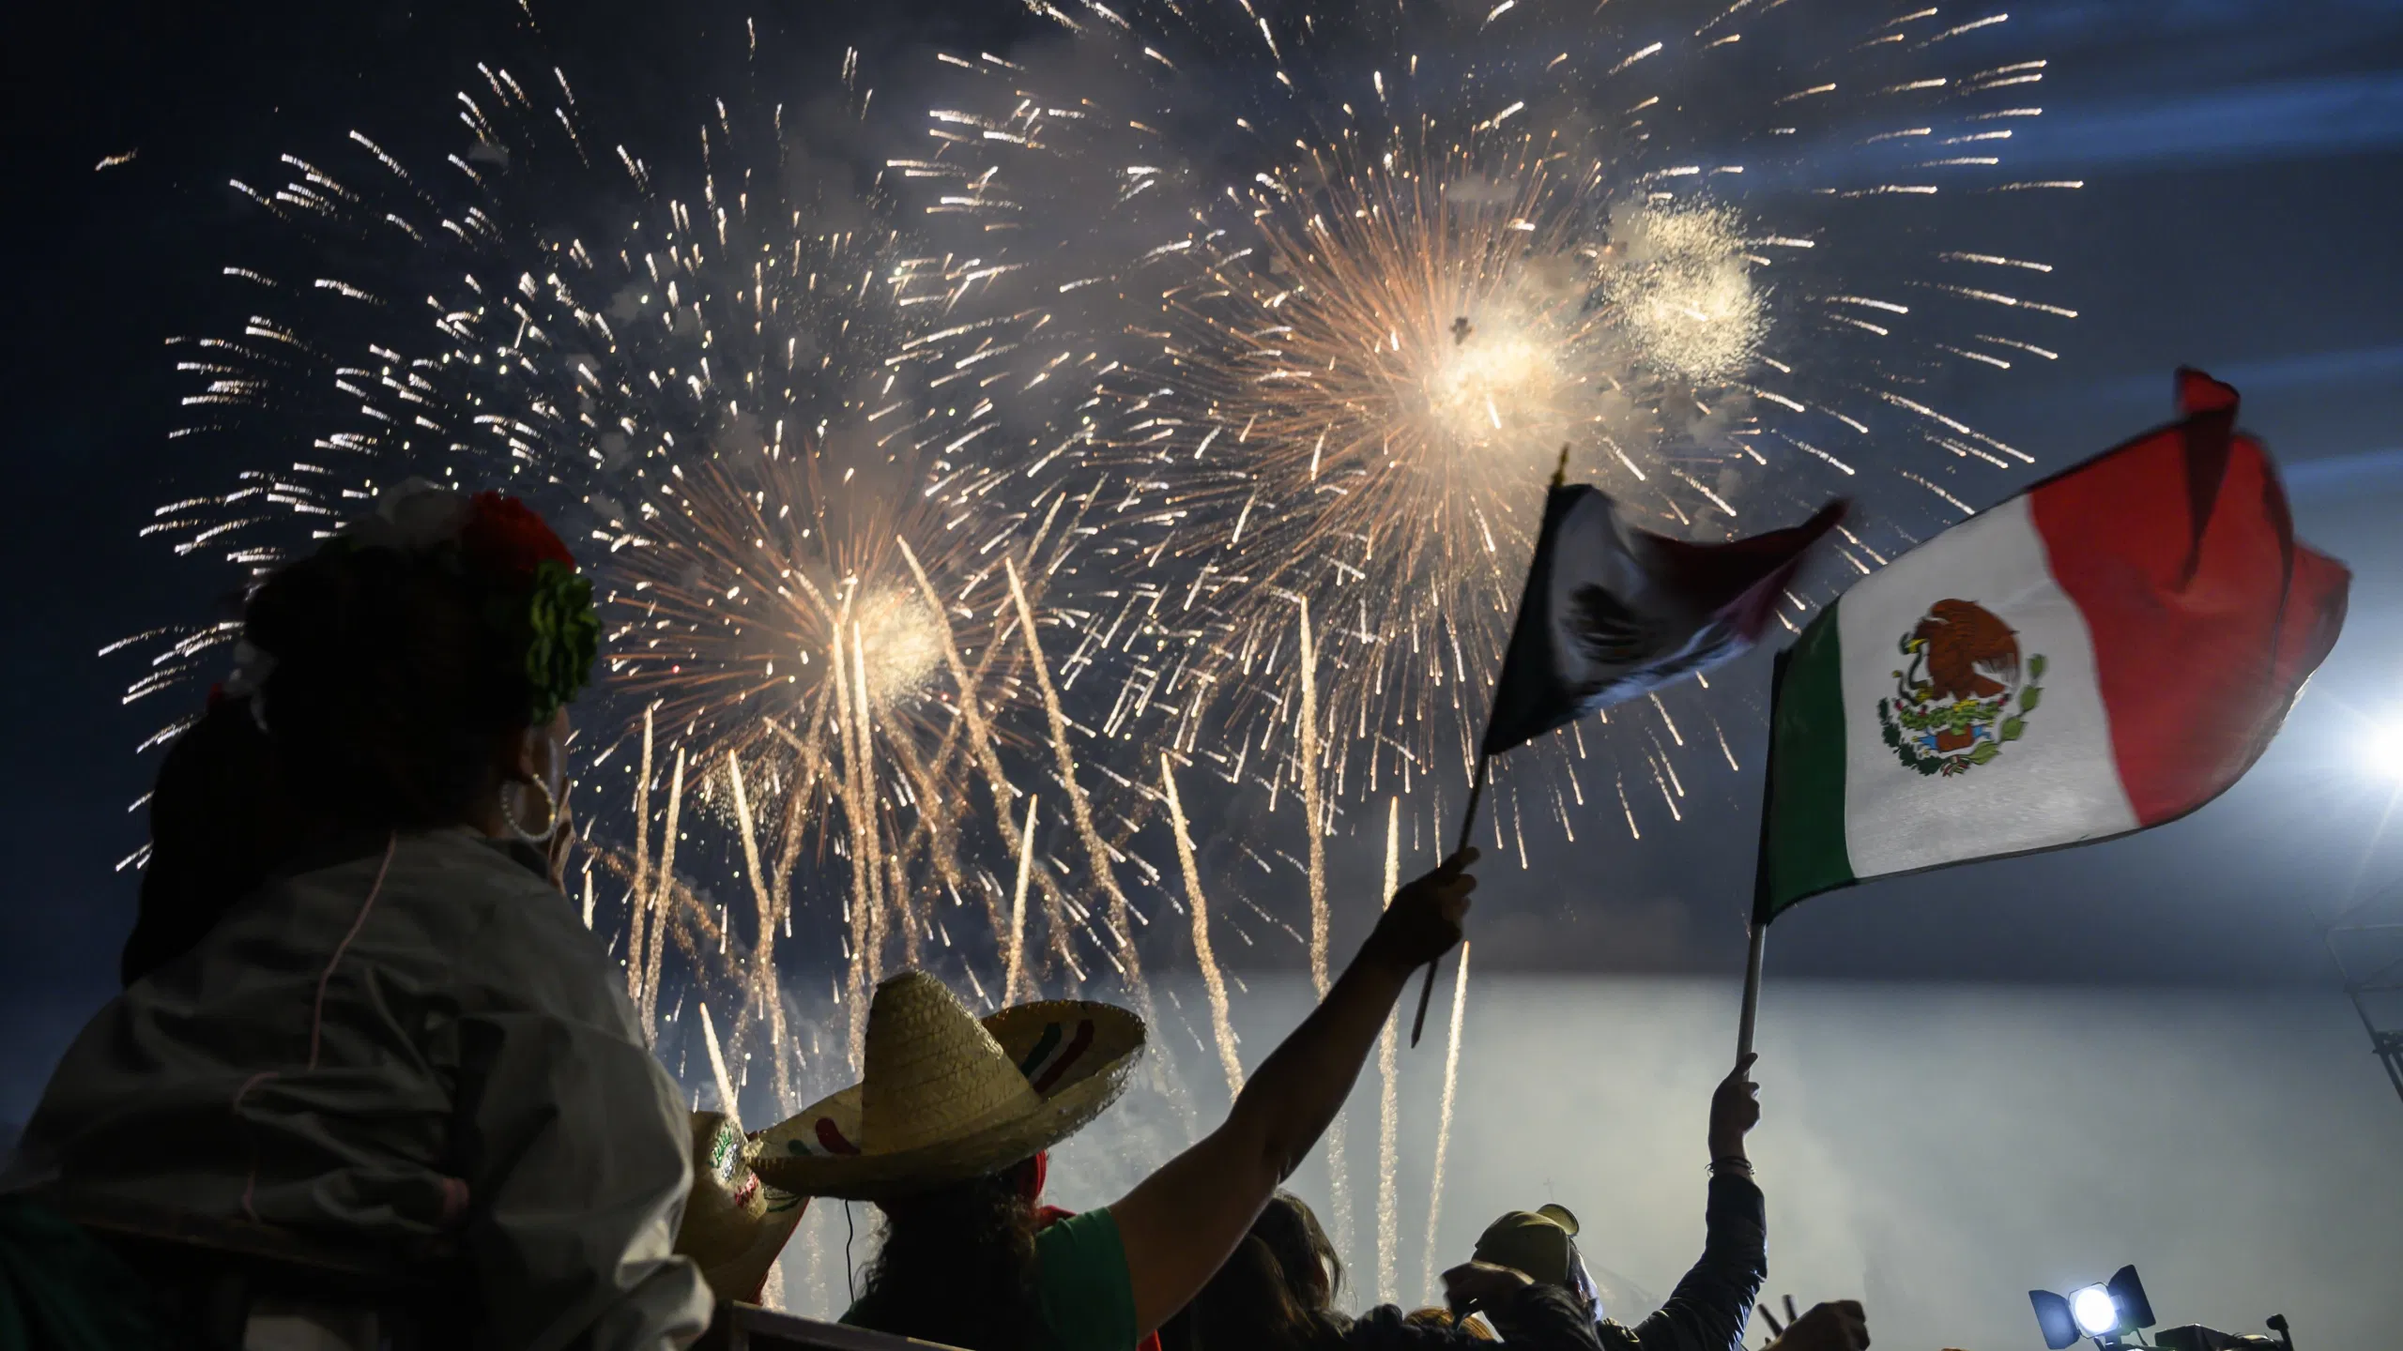

Mexican Independence Day
Human Relations, Diversity & Equity
Student Support and Attendance Services

Slide 2
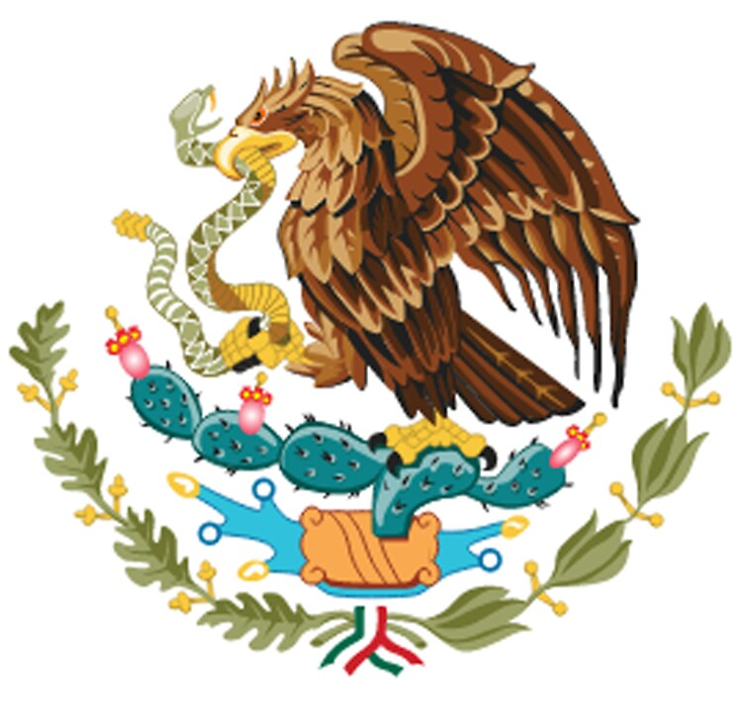
Welcome!
True or False?
Cinco de Mayo is Mexican Independence Day
Notes:
The answer is FALSE – Mexican independence Day is actually September 16th! Keep reading to learn more!

Slide 3
Objectives
Learn about the history of Mexican Independence.
Review the impact of colonization on the indigenous population of Mexico.
Discuss cultural celebrations and traditions.

Slide 4
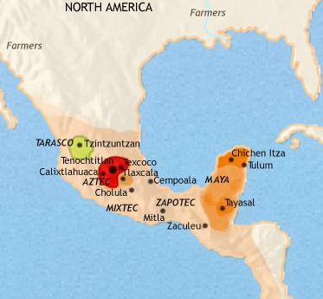
Ancient Civilizations
Ancient Mexico was inhabited by major indigenous civilizations including the Aztec, Maya, Toltec and Teotihuacan.
The first Europeans arrive in Mexico in 1511 as a result of a shipwreck.

Slide 5
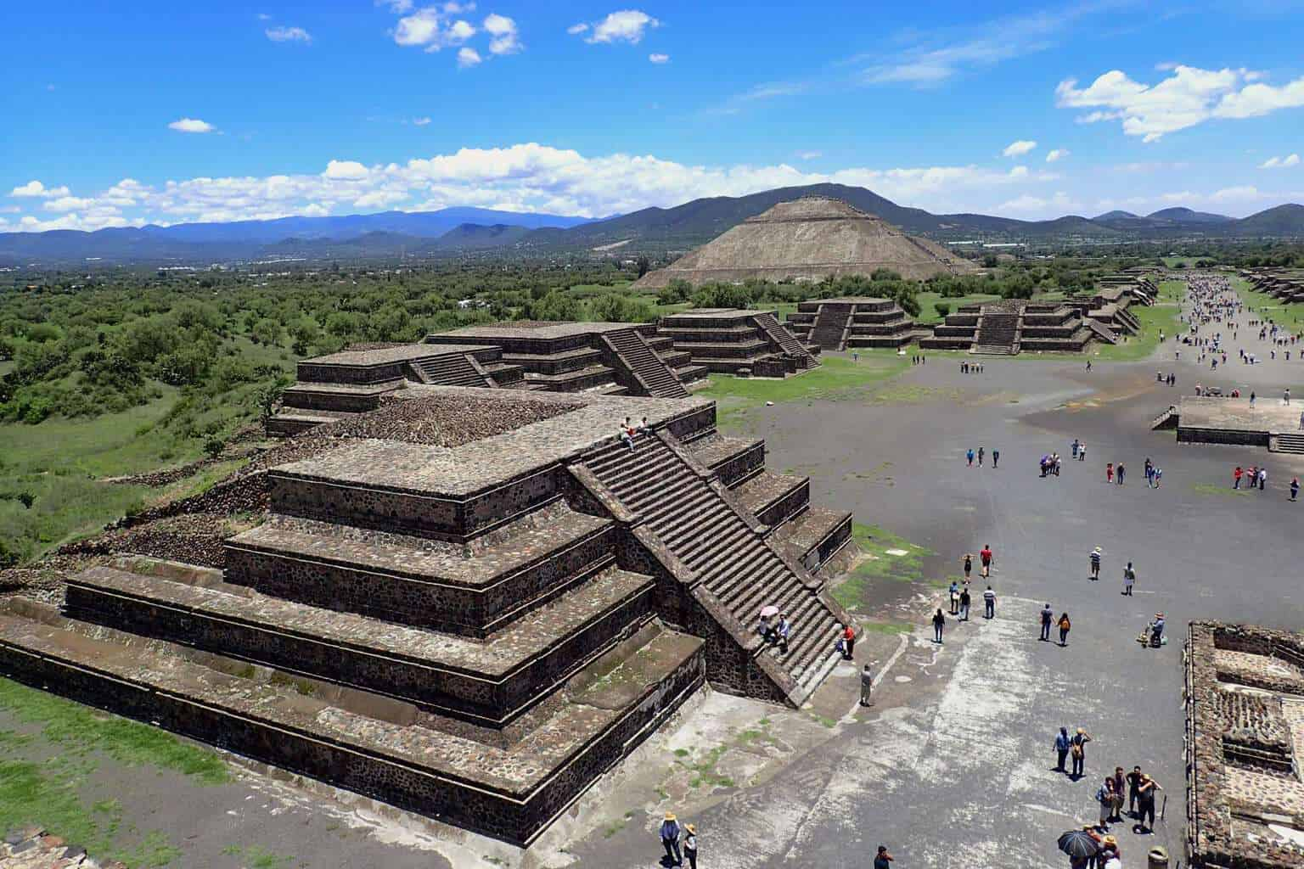
Ancient Ruins
Mexico is full of well-restored archaeological sites showing what life was like thousands of years ago among the ancient civilizations.
These ruins are scattered throughout the country from the towering Mayan pyramids in the Yucatan peninsula to the elaborate ancient Teotihuacan city just outside of modern Mexico City.
Notes:
Pictured: Teotihuacan city just outside of modern Mexico City.

Slide 6
Reflection
Have you ever visited the site of an ancient civilization?
If so, which one?

Slide 7
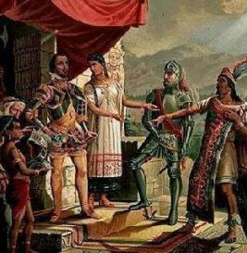
Colonization of Mexico
Spanish explorers arrived in Mexico in 1519 and began 300 years of Spanish rule over the region.
Due to its strategic location between North and South America, the Spanish realized that Mexico was the key to controlling the Americas.
Once there, the Spaniards, under the leadership of Hernán Cortes, conquered the indigenous people and forced them to live by European rule.

Slide 8
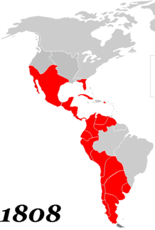
Spanish Colonization of the Americas
In the early 16th century, the Spanish had control over Mexico and most of Latin America.
By the 19th century due to turmoil in Europe, Spain's power in the America's began to weaken.
Mexico was one of the first colonies to rebel, creating a ripple effect throughout Latin America and launching a revolution that would last over a decade.
Notes:
The red picture shows the hold Spain had over the America's.

Slide 9
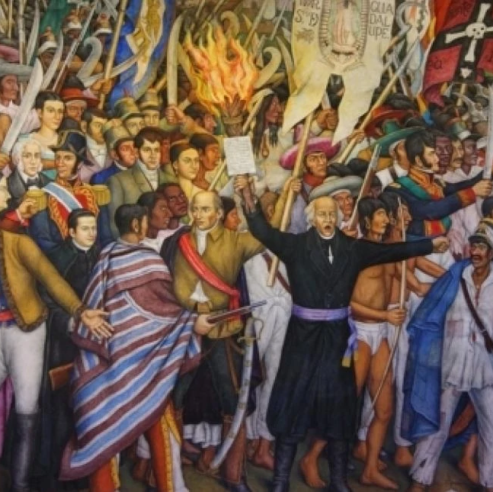
Mexican Independence
The fight for Mexican independence began on September 16th 1810 when the historic battle cry, "El Grito de Dolores" rang out from Father Miguel Hidalgo y Costilla.
The Mexican struggle for independence was not a single, coherent event. In fact, this war lasted 11 years.
Mexico gained independence from Spain through local and regional battles that occurred within the same time period and ultimately continued to weaken Spain's power and led to the revolution.

Slide 10
Reflection
Spain's power in the America's weakened due to problems with France and England in Europe.
How might this have played into the
Mexican Revolution?

Slide 11
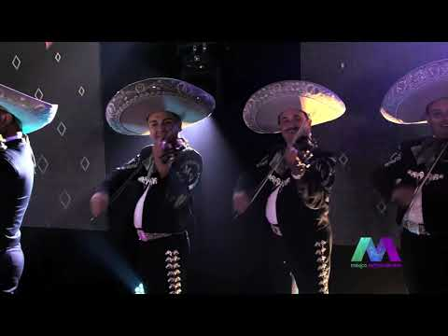
Mexican Independence Day Celebration
Notes:
https://www.youtube.com/watch?v=LSZY9EAV1yk (2:23)

Slide 12
Check Out
What is your favorite celebration in your culture?

Slide 13

Teacher Feedeback Survey
Notes:
Teacher please scan the QR code to complete a quick feedback survey.

Slide 14

For additional resources, visit us at: https://www.lausd.org/human-relations

